Slide 1

CRAFTING
SOLID state
management
A principle based architecture

Slide 2
State Management:
状态管理
Can’t be that hard… Right? But we all felt the pain!

Slide 3
You will:
Understand the principles behind it
Implement based on a meta-model

Slide 4
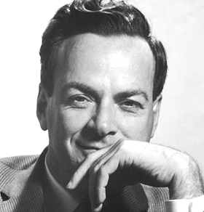
If you cannot explain something in simple terms you don’t know it yourself.
Richard Feynman

Slide 5
Agenda 日程
What is State
When to care about state management
State management principles
State management meta-model

Slide 6






Angular by heart and code
Development, Workshops, Community
开发，研讨，社区

Slide 7
What Is State?
什么是状态？

Slide 8
What of these things is no state?
哪些东西不是状态呢？
Values in an input box
The Browser URL
Collapsed state div
CSS background color
Cache in the browser
Database on the server
The browser cookie
Items in a list
Result of HTTP request
Window scroll position

Slide 9
State can be ANYTHING!
状态可以是任何事物！

Slide 10
When To Care About State Management?
何时需要关注状态管理？

Slide 11
When to care about state management?
Globally accessible data (Multiple Consumers)
Long living data
Need to cached data
Data from remote source
Reproducible state

Slide 12
State Management Principles
状态管理原则

Slide 13



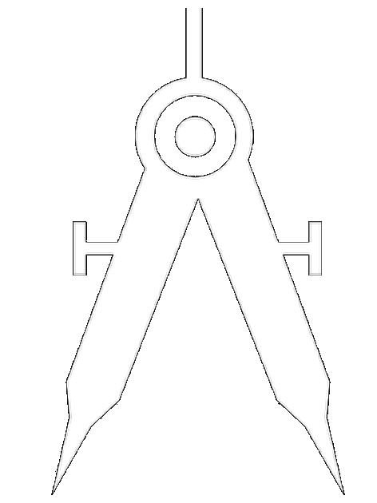
Topics in state management
关于状态管理的话题
State Storage
State Transformation
State Update
State Management Architecture

Slide 14
State Storage
状态储存

Slide 15
State Storage
A separate layer for state
Store state as one single piece
Store data normalized
State is serializable

Slide 16
A separate Layer for state
一个单独的状态层

Slide 17
A separate layer for state
✘
Consumer State1
State2
Consumer State1

Slide 18
A separate layer for state
✔
State2
State1
Consumer
Consumer

Slide 19
A separate layer for state
✔
✘
VS
State2
State1
Consumer State1
State2
Consumer State1
Consumer
Consumer

Slide 20
A separate layer for state
Reduce coupling / Separation of concerns
Logic is reusable
Share state with application

Slide 21
Store state as one single piece
将状态储存在一个单元里

Slide 22
Store state as one single piece
✘
State 2
State 1
State 3

Slide 23
Store state as one single piece
✔
State 1
State 2
State 3

Slide 24
Store state as one single piece
✔
✘
State 2
VS
State 1
State 2
State 3
State 1
State 3

Slide 25
Store state as one single piece
Single point of truth
Reduce redundant data
Avoid cyclic dependencies
Easy to find (one file)

Slide 26
Store data Normalized
规范化数据存储

Slide 27
Store data normalized
✘
List name 1, Todo 1
List name 1, Todo 2
List name 1, Todo 3
List name 2, Todo 1
List name 2, Todo 2
List name 2, Todo 4
Todolists

Slide 28
Store data normalized
✔
List 1
List 2
List
Todo 1
Todo 2
Todo 3
Todo 4
Todo
1, 1
1, 2
1, 3
2, 1
2, 2
2, 4
Todolists

Slide 29
Store data normalized
✔
✘
List name 1
List name 2
List
Todo 1
Todo 2
Todo 3
Todo 4
Todo
Todolists
List name 1, Todo 1
List name 1, Todo 2
List name 1, Todo 3
List name 2, Todo 1
List name 2, Todo 2
List name 2, Todo 4
VS
1, 1
1, 2
1, 3
2, 1
2, 2
2, 4
Todolists

Slide 30
Store data normalized
Reduce redundant data
Reduce store size
Move complexity into derivation layer

Slide 31
State is serializable
状态是可序列化的

Slide 32
State is serializable
✘
A
A,?
B

Slide 33
State is serializable
✔
A
A,B
B

Slide 34
State is serializable
✔
✘
A
A
A,?
VS
A,B
B
B

Slide 35
State is serializable
State is consistent
State is reproducible
State is persistent

Slide 36
State Transformation
状态转换

Slide 37
State Transformation
State is immutable
Functions are pure
Restrict concurrent state changes
State is reproducible

Slide 38
State is immutable
状态是不可更改的

Slide 39
State is immutable
✘
A
B
Transformation
A

Slide 40
State is immutable
✔
A
B
Transformation
C

Slide 41
State is immutable
✔
✘
A
B
A
B
VS
Transformation
Transformation
A
C

Slide 42
State is immutable
Produce clean state changes
State is consistent
State is reproducible

Slide 43
Functions are pure
功能是纯粹的

Slide 44
Functions are pure
✘
A
B
?
Function
C

Slide 45
Functions are pure
✔
A
B
Function
C

Slide 46
Functions are pure
✔
✘
A
B
A
B
?
Function
VS
Function
C
C

Slide 47
Functions are pure
Side-effect free
Easy to test
State is reproducible
Performance / Caching

Slide 48
Restrict concurrent state changes
限制并发的状态更改

Slide 49
Restrict concurrent state changes
✘
1
2
2
1

Slide 50
Restrict concurrent state changes
✔
1
2
1
2

Slide 51
Restrict concurrent state changes
✔
✘
VS
1
2
2
1
1
2
1
2

Slide 52
Restrict concurrent state changes
State is reproducible
State is consistent
Debugging is possible ;-)

Slide 53
State is
Reproducible
状态是可重现的

Slide 54
State is reproducible
✘
State
State
State

Slide 55
State is reproducible
✔
State
State
State

Slide 56
State is reproducible
✘
State
State
State
VS
State
State
State
✔

Slide 57
State is reproducible
Foundation for time-travel Debugging
Foundation for Redo/Undo
Foundation for optimistic updates

Slide 58
State Update
状态更新

Slide 59
State Update
A push based architecture
Only one direction for data
A separate layer for state derivation

Slide 60
Push based
Architecture
基于推送的架构

Slide 61
Push based architecture
✘
Producer
Response
Request
Consumer

Slide 62
Push based architecture
✔
Producer
Subscribe
Broker
Publish
Consumer

Slide 63
Push based architecture
✔
✘
Producer
Producer
Response
Subscribe
VS
Broker
Request
Publish
Consumer
Consumer

Slide 64
Push based architecture
Convenient to use
Data freshness
Reduces complexity in state updates

Slide 65
One direction
for data
数据只有一个方向

Slide 66
One direction for data
✘
State
State
Consumer
Consumer

Slide 67
One direction for data
✔
Mediator
State
State
Consumer
Consumer

Slide 68
One direction for data
✔
✘
Mediator
State
State
State
State
VS
Consumer
Consumer
Consumer
Consumer

Slide 69
One direction for data
Predictable data flow
Avoids loops in updates
Maintainable architecture

Slide 70
A separate layer for state derivation
状态推导的独立层

Slide 71
A separate layer for state derivation
✘
State
Consumer + Query

Slide 72
A separate layer for state derivation
✔
Derivation
State
Query
Consumer
Query

Slide 73
A separate layer for state derivation
✘
State
Consumer + Query
VS
Derivation
State
Query
Consumer
✔
Query

Slide 74
A separate layer for state derivation
Easy to extend
Reduce complexity at consumer side
Reusable derivation logic (DRY)

Slide 75
State Management Architecture
状态管理架构

Slide 76
State Management Architecture
Encapsulate events into objects
Provide events as one source
Hide details behind a facade
Adopt and maintain state is simple

Slide 77
Encapsulate events into objects
把事件封装到对象中

Slide 78
Encapsulate events into objects
✘
Source
Consumer
Data
EventName

Slide 79
Encapsulate events into objects
✔
Source
Data EventName
Consumer

Slide 80
Encapsulate events into objects
✘
Source
Consumer
Data
EventName
VS
✔
Source
Data EventName
Consumer

Slide 81
Encapsulate events into objects
Decouples sender from consumer
Scalable and distributed systems
Server/client architecture (serializable)

Slide 82
Provide events as one source
以单一来源的形式提供事件

Slide 83
Provide events as one source
✘
Middleware
Middleware
Middleware
Event
State
Event
Event
Event
Consumer

Slide 84
Provide events as one source
✔
Event
Middleware
Effect
Stream of events
Event
Consumer
State
Event

Slide 85
Provide events as one source
✘
✔
Middleware
Middleware
Middleware
Event
VS
Middleware
Event
State
Stream of events
Event
Event
Event
Consumer
Consumer
State
Event

Slide 86
Provide events as one source
Easy to keep one direction
Connect remote sources
Reduces complexity in architecture

Slide 87
Hide details behind a facade
隐藏外观后面的细节

Slide 88
Hide details behind a facade
✘
Computation
Consumer
Consumer
Storage
Derivation

Slide 89
Hide details behind a facade
✔
Facade
Computation
Consumer
Storage
Derivation

Slide 90
Hide details behind a facade
✘
✔
Computation
VS
Consumer
Facade
Consumer
Storage
Computation
Derivation
Consumer
Storage
Derivation

Slide 91
Hide details behind a facade
Easy to replace
Blackbox away implementation details
Simplifies accessing and separating state management

Slide 92
Adopt and maintain state is simple
采用和维护状态很简单

Slide 93
Adopt and maintain state is simple
✘
(C) (∃x)(Fx∧∀y(Fy→y=x)(∃x)(Fx∧∀y(Fy→y=x), (∃x)(Gx∧∀y(Gy→y=x)⊢(∃x)(Gx∧∀y(Gy→y=x)⊢ (∃x)(∃y)(¬x=y∧(Fx∨Gx)∧(Fy∨Gy)∧(∀z)(Fz∨Gz→(z=x∨z=y))

Slide 94
Adopt and maintain state is simple
✔
1+1=2

Slide 95
Adopt and maintain state is simple
✘
✔
VS
(C) (∃x)(Fx∧∀y(Fy→y=x)(∃x)(Fx∧∀y
(Fy→y=x), (∃x)-(Gx∧∀y(Gy→y=x)
⊢(∃x)(Gx∧∀y(Gy→y=x)⊢(∃x)(∃y)
(¬x=y∧(Fx∨Gx)∧(Fy∨Gy)∧(∀z)
(Fz∨Gz→(z=x∨z=y))
1+1=2

Slide 96
Adopt and maintain state is simple
Scaffold what you can
Blueprints for every implementation
Start simple

Slide 97
State Management
Meta-Model
状态管理元模型

Slide 98
State Management Meta-Model
Meta-model sections
Computation
Event propagation
Computation
Storage
Derivation
State propagation
Event
Storage
Derivation
Consumer

Slide 99



Michael Hladky
Thanks for your time!
Don’t hesitate to ask me anything!
谢谢！！！
michael@hladky.at github.com/BioPhoton angular-college.com

